Slide 1
SQL Analysis of E-Commerce Orders
Prepared by: [KARAN SINGH RAWAT]

Slide 2
Introduction
Objective: Analyze customer orders and purchasing behavior using SQL queries.
Dataset: Orders, Customers, Order Items.

Slide 3
Database Schema Overview
Tables:
- orders (order_id, customer_id, total_amount, status)
- order_items (order_id, product_name, quantity, price_per_unit)
- customers (customer_id, customer_name, country, signup_date)

Slide 4
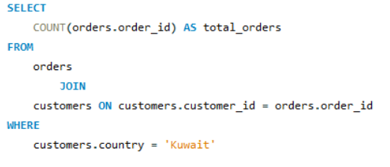
Total Orders from Kuwait
Query:
Explanation: Counts all orders placed by customers from Kuwait.

Slide 5
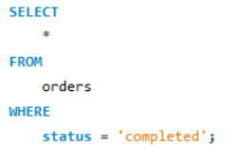
Completed Orders
Query:
Explanation: Retrieves all completed orders.

Slide 6
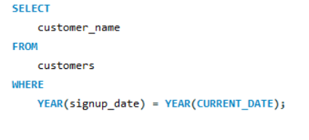
Customers Signed Up This Year
Query:
Explanation: Finds customers who joined in the current year.

Slide 7
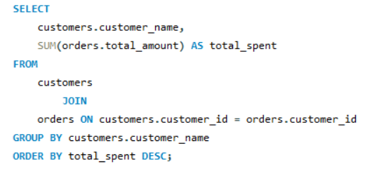
Total Amount Spent by Each Customer
Query:
Explanation: Shows the highest-spending customers.

Slide 8
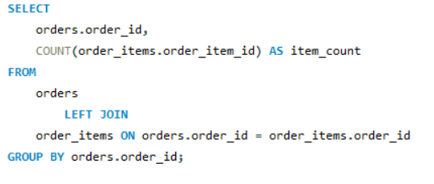
Orders with Total Items
Query:
Explanation: Counts total items per order.

Slide 9
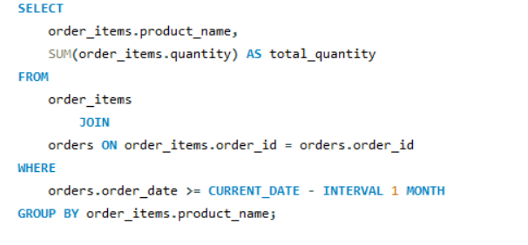
Products Purchased in the Last Month
Query:
Explanation: Lists all products sold in the last month.

Slide 10
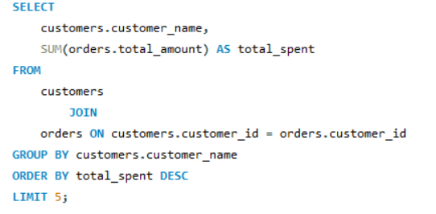
Top 5 Customers by Spending
Query:
Explanation: Identifies the top 5 customers with the highest spending.

Slide 11
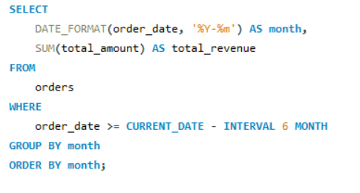
Monthly Revenue Report (Last 6 Months)
Query:
Explanation: Generates revenue trends.

Slide 12
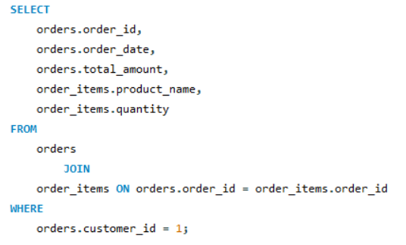
Customer Order History
Query:
Explanation: Fetches detailed order history for a customer.

Slide 13
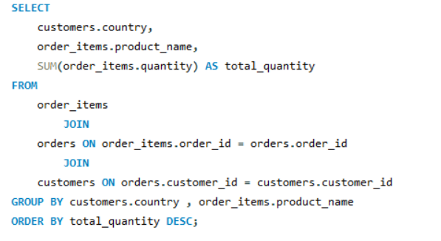
Most Popular Product by Country
Query:
Explanation: Identifies top-selling products per country.

Slide 14
Challenges & Optimizations
- Challenges:
Handling large datasets, query performance issues.
- Optimizations: Using indexes on customer_id, order_id, optimizing JOIN operations.

Slide 15
Conclusion & Insights
- Total revenue in the last 6 months was highest in [27492.85].
- The most popular product globally is [Mouse].
- Kuwait had 9 total orders.

